Slide 1
UNIT-IV Topic: Turing Machine

Slide 2
Turing Machine
A Turing Machine is a simple mathematical model of a computer. It models the computational capability of a general purpose computer.
It was designed by “Alen Turing”.
It is a generalized machine, which can recognize all types of languages that is, Regular Language, Context Free Language and Context Sensitive Language. Apart from these languages, the TM also accepts the language generated by Unrestricted Grammar.
Thus, the TM can accepts any generalized language.

Slide 3
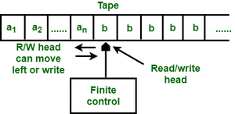
The Turing Machine Model
Components of TM model are:
Input Tape
Read-Write head
Control Unit

Slide 4
Input Tape:
It is a temporary storage and divided into cells.
Each cell can store the information of only one symbol.
The string to be scanned will be stored from the left most position on the tape.
The string to be scanned should end with infinite number of blanks.
2. Read-Write Head:
It can read a symbol from where it is pointing to and it can write into tape to where it is pointing to.
3. Control Unit:
the reading or writing from or to the tape is determined by the control unit.

Slide 5
The action (one move) performed by TM depends on the
i. current state
ii. Whole string to be scanned
iii. The current position of the Read-Write head
The action(one move) performed by TM consists of the
i. Changes state
ii. Prints a symbol on the tape cell scanned, replacing what was written there
iii. Moves its head left or right one cell
Note: In 2-DFA tape head is used for only reading purpose but in TM tape head is used for read and write purpose.

Slide 6
Description of TM:
Formally, a TM is denoted (7 tuples)
M= (Q, ∑, ┌, ⸹, q₀, B, F)
Where
Q is the finite set of states,
┌ is the finite set of allowable tape symbols,
B, a symbol of ┌, is the blank,
∑, a subset of ┌ not including B, is the set of input symbols,
⸹ is the next move function, a mapping from Q x ┌ to Q x ┌ x {L,R}
q₀ in Q is the start state,
F is set of final states. It is subset of Q

Slide 7
Instantaneous Description(ID) of the TM
The internal configuration of TM at some particular instance of time is called ID of TM.
It is described as : α₁ P α₂
where, P is current state and α₁α₂ € ┌*
The next symbol to be processed is the first symbol of α₂
the initial configuration of TM is: q₀w

Slide 8
Acceptance of TM
The language accepted by M, denoted L(M), is the set of those words in ∑* that cause M to enter a final state when placed, justified at the left, on the tape of M, with M in state q₀, and the tape head of M at the leftmost cell.
The language accepted by M= (Q, ∑, ┌, ⸹, q₀, B, F) is
TM halts, Whenever the input is accepted otherwise TM will never halt.

Slide 9
Ex : 1. design a TM to accept L={0^{n}1^{n}|n>=1}
Initially, the tape of M contains 0^{n}1^{n} followed by an infinity of blanks.
Repeatedly, M replaces the leftmost 0 by X, moves right to the leftmost 1, replacing it by Y, moves left to find the rightmost X, then moves one cell right to the leftmost 0 and repeats the cycle.
If, when searching for a 1, M finds a blank instead, then M halts without accepting.
┌ = {0,1,X,Y,B}, ∑ = {0,1}

Slide 10
The Function ⸹
Symbol
State | 0 | 1 | X | Y | B
q0 | (q₁,X,R) | -- | -- | (q₃,Y,R) | --
q1 | (q₁,0,R) | (q₂,Y,L) | -- | (q₁,Y,R) | --
q₂ | (q₂,0,L) | -- | (q₀,X,R) | (q₂,Y,L) | --
q₃ | -- | -- | -- | (q₃,Y,R) | (q₄,B,R)
q₄ | -- | -- | -- | -- | --

Slide 11
A computation of M
q₀ 0011 |--- Xq₁011 |--- X0q₁11 |--- Xq₂0Y1
|--- q₂X0Y1 |--- Xq₀0Y1 |--- XXq₁Y1
|--- XXYq₁1 |--- XXq₂YY |--- Xq₂XYY
|--- XXq₀YY |--- XXYq₃Y |--- XXYYq₃
|--- XXYYBq₄
* q₄ is final state so the string 0011 is accepted by TM.

Slide 12
Transition Diagram

Slide 13
Ex : 2. design a TM to accept L={0^{n}1^{n}2^{n}|n>=1}
Transition table for TM:

Slide 15
3. Design TM that accepts L={w|wϵ(0+1)*} containing the sub string 001.
The DFA which accepts the language consisting of string of 0’s and 1’s having a sub string 001 is shown below:

Slide 16
The transition table for the DFA is:
The transition table of TM and DFA are same. Because DFA processes the input string from left to right in only one direction, TM also processes in same manner.

Slide 17
So the transition table for the TM which accepts the language containing of string having 001 as substring is:

Slide 19
4. Design TM that accepts L={w|wϵ(0+1)*} strings end with 011.
The DFA transition diagram is:

Slide 21
TM transition table is:

Slide 23
5. Design TM that accepts L={w|w is even and ∑ ={a,b} }.

Slide 24
TM transition table is:

Slide 26
6. Design TM, that accepts a palindrome
TM transition table is:
State | 0 | 1 | B
q₀ | (q₁,B,R) | (q₂,B,R) | (q₆,B,R)
q₁ | (q₁,0,R) | (q₁,1,R) | (q₃,B,L)
q2 | (q₂,0,R) | (q₂,1,R) | (q₄,B,L)
q3 | (q₅,B,L) |  | (q₆,B,R)
q4 |  | (q₅,B,L) | (q₆,B,R)
q5 | (q₅,0,L) | (q₅,1,L) | (q₀,B,R)
*q₆

Slide 27
7. Design a TM, that accepts L={ww^{r}|wϵ(a+b)*}
Transition table for TM is:
State | a | b | B
q₀ | (q₁,B,R) | (q₂,B,R) | (q₆,B,R)
q₁ | (q₁,a,R) | (q₁,b,R) | (q₃,B,L)
q₂ | (q₂,a,R) | (q₂,b,R) | (q₄,B,L)
q₃ | (q₅,B,L)
q₄ |  | (q₅,B,L)
q₅ | (q₅,a,L) | (q₅,b,L) | (q₀,B,R)
*q₆

Slide 28
8.

Slide 30
Techniques for Turing Machine Construction
Storage in the finite control
Turing Machine with multiple tracks
Checking off symbols
Shifting over
Subroutines

Slide 31
1. Storage in the finite control
The finite control can be used to hold some finite amount of information.
To do so, the state is written as a pair of elements, one exercising control and the other storing a symbol.
It should be emphasized that this arrangement is for conceptual purposes only. No modification in the definition of the Turing Machine has been made.
Ex: Consider a TM that looks at the first input symbol, records it in its finite control, and checks that the symbol does not appear else where on its input.
⸹([q₀,B],0) = ([q₁,0],0,R), ⸹([q₀,B],1) = ([q₁,1],1,R),
⸹([q₁,0],1) = ([q₁,0],1,R), ⸹([q₁,1],0) = ([q₁,1],0,R),
⸹([q₁,0],B) = ([q₁,B],0,L), ⸹([q₁,1],B) = ([q₁,B],0,L)

Slide 32
2. Multiple Tracks
We can imagine that the tape of the TM is divided into k tracks, for any finite k.
The symbols on the tape are considered k-tuples, one component for each track.
₵ | 1 | 0 | 1 | 1 | 1 | 1 | $ | B | B | ……………..
B | B | B | B | 1 | 0 | 1 | B | B | B | …………
B | 1 | 0 | 0 | 1 | 0 | 1 | B | B | B | …………
Finite Control

Slide 33
Ex: This is a TM which takes a binary number as input and checks whether it is prime or not.
First track contains input which is surrounded by ₵ and $.
The binary number 2 is copied on the second track.
The content of the first track is copied on to the third track.
Then the second track is subtracted as many times as possible from the third track, affectively dividing the third track and leaving the reminder.
If the reminder is 0,then the number on the first track is not prime.
The reminder is not 0 then the number on the second track is incremented by 1 and the process is repeated.

Slide 34
3. Checking off Symbols
It is a useful trick for visualizing how a TM recognizes languages defined by repeated strings such as
{ww | w in ∑*}, {wcy | w and y in ∑*, w!=y} or {ww^{R} | w in ∑*}
It is also useful when lengths of substrings must be compared.
We introduce an extra track on the tape that holds a blank or tick.
The tick appears when the symbol below it has been considered by the TM in one of its comparisons.

Slide 35
4. Shifting Over
A TM can make space on its tape by shifting all nonblank symbols a finite number of cells to the right.
To do so, the tape head makes an excursion to the right, repeatedly storing the symbols read in its finite control and replacing them with symbols read from cells to the left.
The TM can then return to the vacated cells and print symbols of its choosing.
If space is available, it can push blocks of symbols left in a similar manner.

Slide 36
5. Subroutines
A TM can simulate any type of subroutine found in programming languages.
It can be used to compute multiplication of numbers which includes a subroutine for adding two numbers.
The idea is to write part of TM program to serve as a subroutine; It will have a designated input parameters state and a designated return state. Which will be used to return to the calling routine.

Slide 37
Turing Machine has computation functions: 1. Design a TM which computes the addition of two positive numbers.
Sol:
Input: the input tape contains 0^{m}10^{n} ended with blank symbols.(0001000B)
Output: after computation tape should contain 0^{m+n} ended with blank symbols.(000000B)
Transitions:
⸹(q₀,0) = (q_{0,}0,R), ⸹(q₀,1) = (q_{1,}0,R)
⸹(q₁,0) = (q_{1,}0,R), ⸹(q₁,B) = (q_{2,}B,L)
⸹(q₂,0) = (q₃, B,R)

Slide 38
Transition Table:
State | 0 | 1 | B
q₀ | (q₀,0,R) | (q₁,0,R)
q1 | (q₁,0,R) |  | (q₂,B,L)
q2 | (q₃,B,R)
*q₃

Slide 39
Transition Diagram:
0|0,R 0|0,R
1|0,R B|B,L 0|B,R
Process:
q₀0001000B |--- 0q₀001000B |--- 00q₀01000B |--- 000q₀1000B
|--- 0000q₁000B |--- 00000q₁00B |--- 000000q₁0B
|--- 0000000q₁B |--- 000000q₂0B |--- 000000Bq₃B
q₃ is a final state, so TM produces addition of two numbers.
q₀
q₁
q₂
q₃
q₃

Slide 40
2. Design a TM which computes the proper subtraction.
Proper subtraction is “m-n” when m>=n and 0 when m<n.
It is represented by
Initially tape contains 0^{m}10^{n} surrounded by blanks and after computation TM holds surrounded by blanks on tape.

Slide 41
Transition Table:

Slide 42
3. Design a TM which computes the Multiplication.
The TM starts with 0^{m}10^{n} on its input tape and ends with 0^{m.n} on its tape surrounded by blanks.
The idea is to place a symbol 1 after 0^{m}10^{n} to get 0^{m}10^{n}1.
Now copy the block of n 0s on to the right m times, each time erasing one of the m 0s and the result is 10^{n}10^{m.n} .
Finally the prefix 10^{n}1 is erased leaving 0^{m.n} on the tape.

Slide 43
Step-1: initially the tape contains 0^{m}10^{n}1.
Step-2: convert the leftmost 0 of 0^{m} into blank and move right. when a
1 is seen change state.
Step-3: now we need to transfer the n 0’s to the right of 1. in state q₂ convert the leftmost 0 to X and move right to convert the blank to 0. in moving right when a 1 is seen change the state and in this state convert the blank to 0.

Slide 44
Step-4: after changing a blank to 0, move left until an ‘X’ is seen and go to q₂. repeat above process until n 0’s have been shifted.
Step-5: If in state q₂ a ‘1’ is seen instead of ‘0’. It indicates that all n 0’s are shifted. So we need to go back to find the leftmost 0 of the m 0’s and start second iteration.

Slide 45
Step-6: After m iterations all n 0’s are shifted m times, to get m.n 0’s to the extreme right. Now the content on the tape is 10^{n}10^{m.n}BB. Remove 10^{n}1 part so that 0^{m.n} is remains on the tape.

Slide 46
Variations or Types of TMs:
Two-way infinite tape
Multitape Turing machines
Nondeterministic Turing machines
Multidimensional Turing machines
Multihead Turing machines
Off-line Turing machines

Slide 47
1. Two-way infinite tape TM
It is denoted as same as original model.(7 tuples)
The tape is infinite to the left as well as to the right.
A two way infinite tape TM can move indefinitely in either direction.
This can be shown to be equivalent to a one way infinite tape TM by the following argument:
It is clear that two one-way infinite tape TMs can be used to simulate a two-way infinite tape. If these are lined up ”side by side” and the two tapes are interleaved, then a single one-way infinite TM can be constructed which is equivalent.

Slide 48
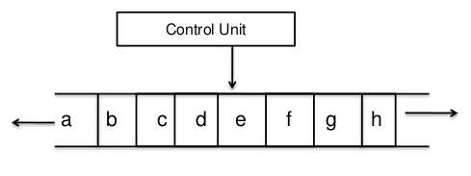

Slide 49
2. Multitape Turing machines
Multi-tape Turing Machines have multiple tapes where each tape is accessed with a separate head.
Each head can move independently of the other heads.
Initially the input is on tape 1 and others are blank. At first, the first tape is occupied by the input and the other tapes are kept blank.
Next, the machine reads consecutive symbols under its heads and the TM prints a symbol on each tape and moves its heads.

Slide 50
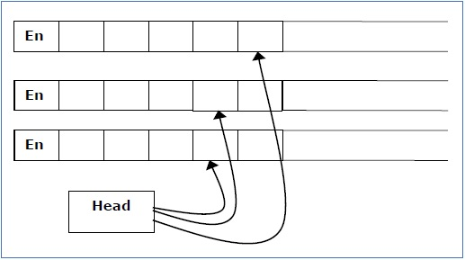
A Multi-tape Turing machine can be formally described as a 6-tuple (Q, X, B, δ, q₀, F) where −
Q is a finite set of states
X is the tape alphabet
B is the blank symbol
δ is a relation on states and symbols where
δ: Q × X^{k} → Q × (X × {Left_shift, Right_shift, No_shift })^{k}
where there is k number of tapes
q₀ is the initial state
F is the set of final states
Note − Every Multi-tape Turing machine has an equivalent single-tape Turing machine.

Slide 51
3. Nondeterministic Turing machines
In a Non-Deterministic Turing Machine, for every state and symbol, there are a group of actions the TM can have. So, here the transitions are not deterministic.
The computation of a non-deterministic Turing Machine is a tree of configurations that can be reached from the start configuration.
An input is accepted if there is at least one node of the tree which is an accept configuration, otherwise it is not accepted.
If all branches of the computational tree halt on all inputs, the non-deterministic Turing Machine is called a Decider and if for some input, all branches are rejected, the input is also rejected.

Slide 52
A non-deterministic Turing machine can be formally defined as a 6-tuple (Q, X, ∑, δ, q₀, B, F) where −
Q is a finite set of states
X is the tape alphabet
∑ is the input alphabet
δ is a transition function;
δ : Q × X → P(Q × X × {Left_shift, Right_shift}).
q₀ is the initial state
B is the blank symbol
F is the set of final states

Slide 53
4. Multidimensional Turing machines
This has usual finite control, but the tape consists of a k-dimensional array of cells infinite in all 2k directions, for some fixed k.
Depending on the state and symbol scanned, the devise changes state, prints a new symbol, and moves its tape head in one of 2k directions.
Multi dimensional tape Turing machine can be simulated by one-dimensional Turing machine

Slide 54
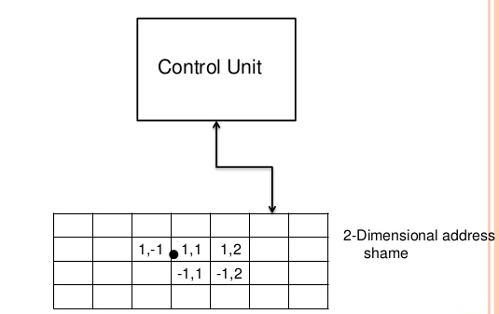

Slide 55
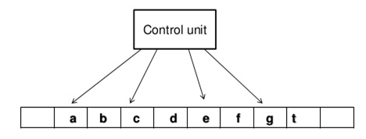
5. Multihead Turing machines
A multi-head Turing machine contain two or more heads to read the symbols on the same tape.
In one step all the heads sense the scanned symbols and move or write independently.
Multi-head Turing machine can be simulated by single head Turing machine.

Slide 56
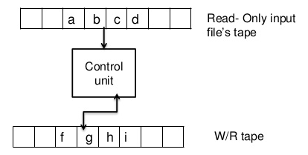
6. Off-line Turing machines
An offline TM has two tapes
1. one tape is Read-only and contains input.
2. the other is Read-Write and is initially blank.
Every standard TM simulated by Off-line TM and vice versa.

